Slide 1
Chapter 7 Single-Dimensional Arrays

Slide 2
Sorting Arrays
Sorting, like searching, is also a common task in computer programming. Many different algorithms have been developed for sorting. This section introduces a simple, intuitive sorting algorithms: selection sort.

Slide 3
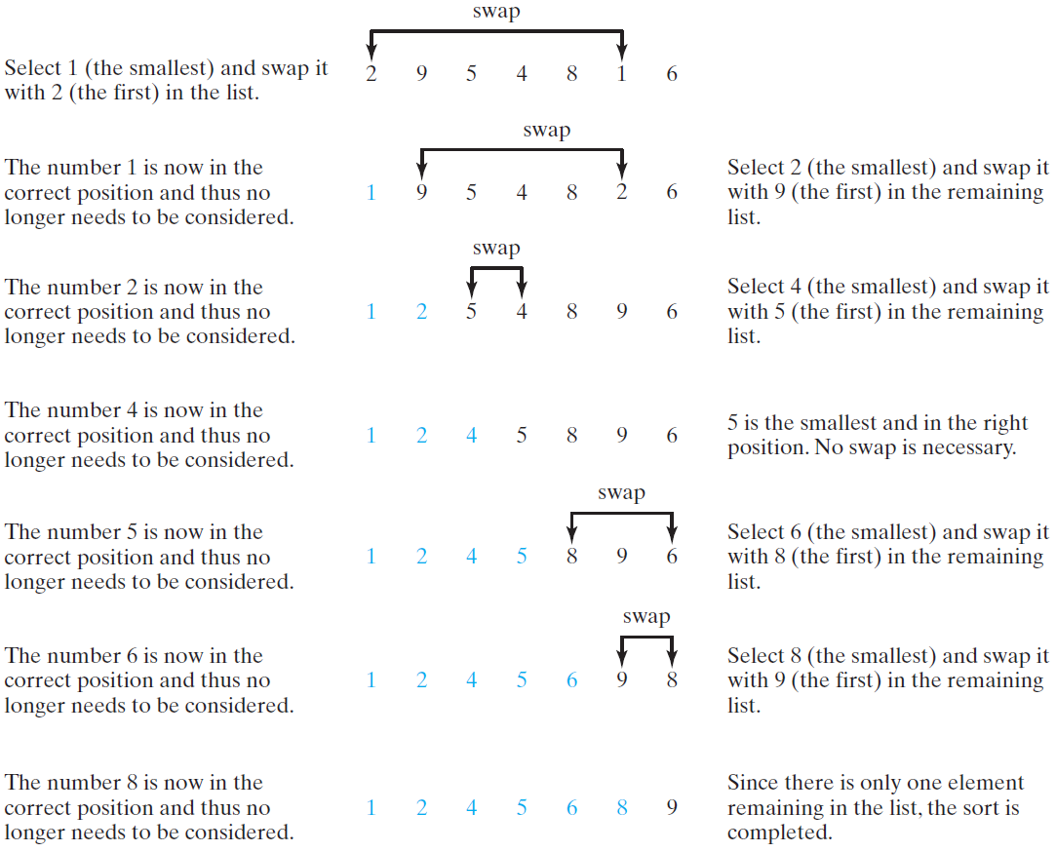
Selection Sort
Selection sort finds the smallest number in the list and places it first. It then finds the smallest number remaining and places it second, and so on until the list contains only a single number.

Slide 4
From Idea to Solution
for (int i = 0; i < list.length; i++) {
select the smallest element in list[i..listSize-1];
swap the smallest with list[i], if necessary;
// list[i] is in its correct position.
// The next iteration apply on list[i+1..listSize-1]
}
list[0] list[1] list[2] list[3] ... list[10]
list[0] list[1] list[2] list[3] ... list[10]
list[0] list[1] list[2] list[3] ... list[10]
list[0] list[1] list[2] list[3] ... list[10]
list[0] list[1] list[2] list[3] ... list[10]
...
list[0] list[1] list[2] list[3] ... list[10]

Slide 5
Wrap it in a Method
/** The method for sorting the numbers */
public static void selectionSort(double[] list) {
for (int i = 0; i < list.length; i++) {
// Find the minimum in the list[i..list.length-1]
double currentMin = list[i];
int currentMinIndex = i;
for (int j = i + 1; j < list.length; j++) {
if (currentMin > list[j]) {
currentMin = list[j];
currentMinIndex = j;
}
}
// Swap list[i] with list[currentMinIndex] if necessary;
if (currentMinIndex != i) {
list[currentMinIndex] = list[i];
list[i] = currentMin;
}
}
}
Invoke it
selectionSort(yourList)

Slide 6
The Arrays.sort Method
Since sorting is frequently used in programming, Java provides several overloaded sort methods for sorting an array of int, double, char, short, long, and float in the java.util.Arrays class. For example, the following code sorts an array of numbers and an array of characters.
double[] numbers = {6.0, 4.4, 1.9, 2.9, 3.4, 3.5};
java.util.Arrays.sort(numbers);
char[] chars = {'a', 'A', '4', 'F', 'D', 'P'};
java.util.Arrays.sort(chars);
Java 8 now provides Arrays.parallelSort(list) that utilizes the multicore for fast sorting.

